Slide 1
Resp technology

Slide 2


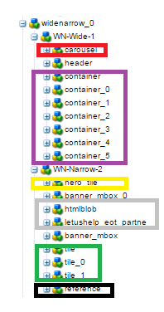

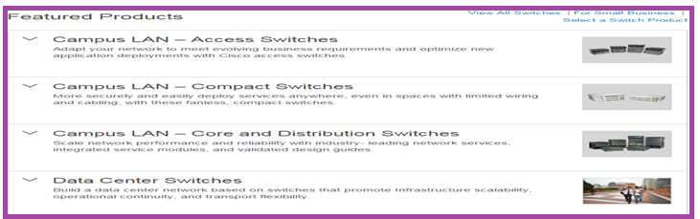
http://www.cisco.com/c/en/us/products/switches/technology.html

